Slide 1
KPMG Sprocket Central
ANALYTICS DASHBOARD
Submitted by:
Somya Bhushan
KPMG Virtual Internship

Slide 2
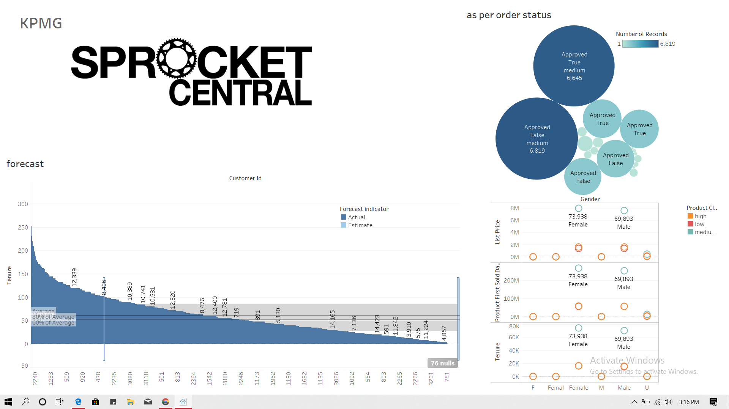

Slide 3
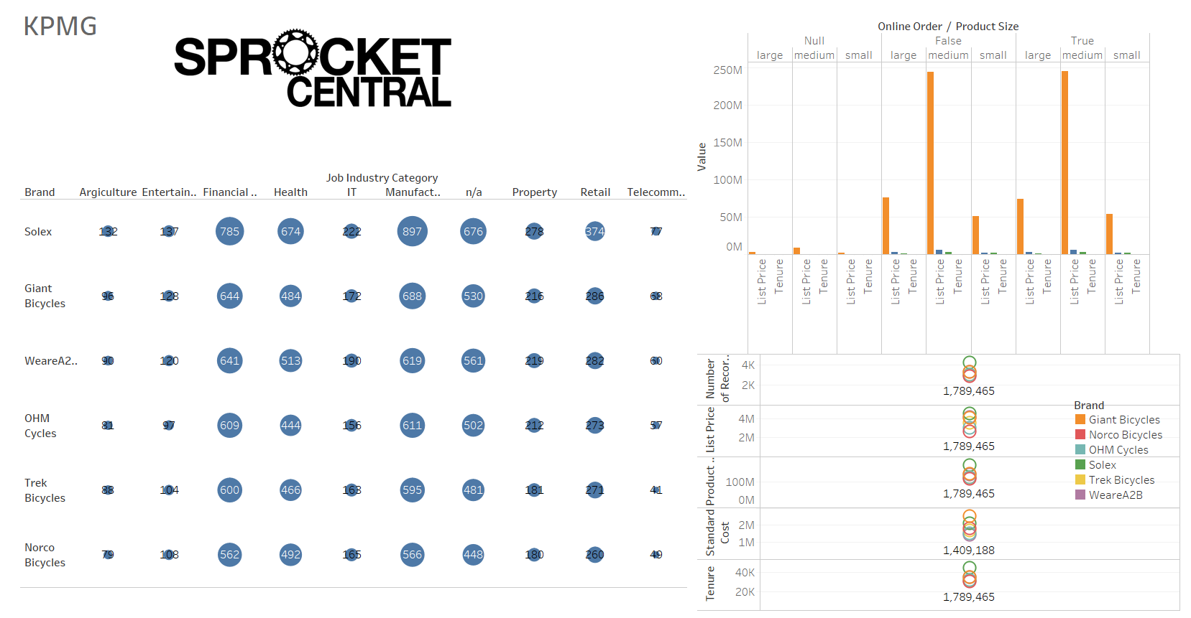

Slide 4
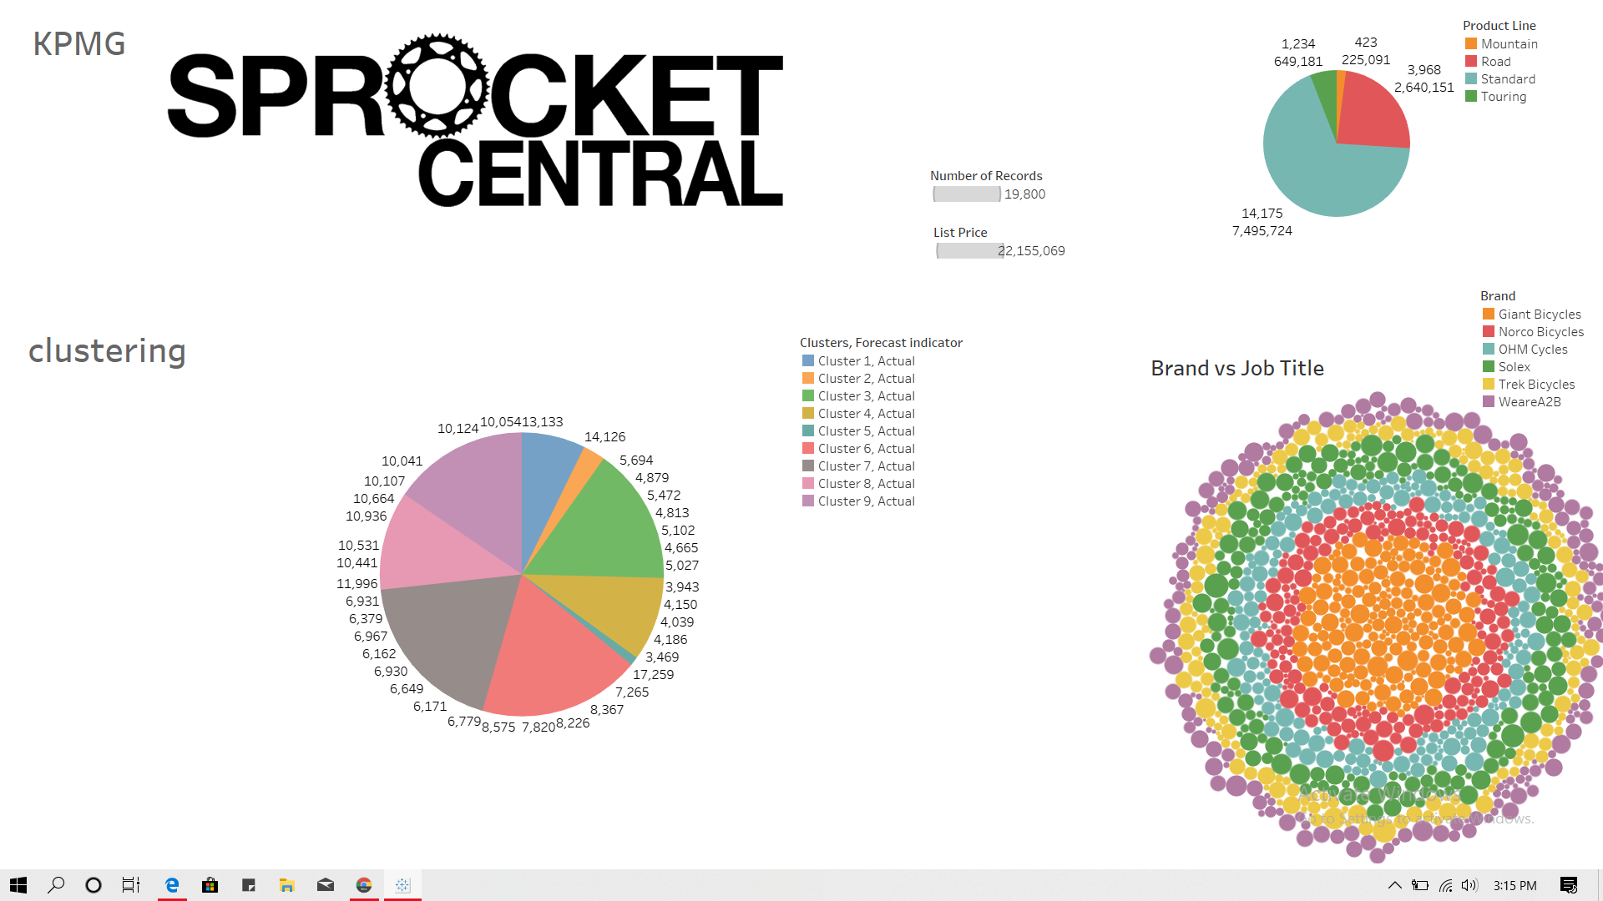

Slide 5
Thank You!

